Slide 1
Summer Holidays
School year 2019-2020

Slide 2
Communication is not that easy!
We have two ears and one mouth so that we can listen twice as much as we speak. ― Epictetus, a Greek philosopher
Discuss the questions.
• What does the quote mean? Do you agree with it?
• When we communicate, what is more important: listening or talking?
• What are the qualities of a good communicator?
• What problems might occur when communicating with someone?

Slide 3
feedback thoughts ideas confusion meaning misunderstanding miscommunication message animosity
feedback
thoughts
meaning
message
feedback
ideas
misunderstanding
message
misunderstanding
confusion
thoughts
feedback
miscommunication
miscommunication
confusion
animosity

Slide 4
Fill in the sentences with the correct form of the verbs from the table above and then discuss these points.
Asking people questions usually ______________ miscommunication.
•One of the most common reasons that __________misunderstandings is the use of complicated sentence structures.
•It only makes sense to __________ positive feedback as it keeps everyone happy.
•People with various knowledge, experience and cultural backgrounds ____________ messages in a different way.
prevents
leads to
share
interpret

Slide 5
Watch the first part of a video(to 3:10) titled “How miscommunication happens (and how to avoid it)” and choose correct answers.
1)The transmission model:
A. means that communication is a one-way process
B. involves communicating complex concepts
C. Includes feedback from the other person
2)In the transactional model:
A. there is no exchange of information
B. just one person assignsmeaning
C. People give and receive feedback
3)Perceptual filters....
A. improve communication by adding extra information
B. limit the number of messages we receive
C. change meanings and interpretation of messages we receive

Slide 6
Complete these rules of good communication with words from the video.
filters gut open express engage
#1:___________ actively with the verbal and nonverbal feedback of others, and adjust your message to facilitate greater understanding.
#2:Listen with your eyes and ears, as well as with your__________. Remember that communication is more than just words.
#3:In the rush to __________ ourselves, it's easy to forget that communication is a two-way street. Be __________ to what the other person might say.
#4:Be aware of your personal perceptual __________. Elements of your experience, including your culture, community, and family, influence how you see the world.
Engage
gut
express
open
filters
Watch the second part of the video (from 3:10) and check your answers in the previous exercise

Slide 7
Discuss the questions.
Do you think that people tend to use too many words to communicate their ideas?
What can we do to be better communicators?
In what kinds of situations do you have to ask someone to rephrase what they’ve said?

Slide 8
Match phrases to correct categories.
You want to explain/clarify something you’ve already said
You want someone to clarify what they’ve said
You didn’t hear something
You want to check if you understand what someone has just said

Slide 9
Match phrases to correct categories.
You want to explain/clarify something you’ve already said
•In other words, ...
•I don’t quite follow....
•Can you elaborate on that?
•I don’t fully understand...
•Could you be more specific?
•I didn’t catch that.
•Could you repeat?
•To put it another way...
•Just to be clear, you’re suggesting that...
You want someone to clarify what they’ve said
You want someone to clarify what they’ve said
You want someone to clarify what they’ve said
You didn’t hear something
You didn’t hear something
You want to explain/clarify something you’ve already said
You want to check if you understand what someone has just said

Slide 10
You want to explain/clarify something you’ve already said
To be more specific....
•Can you say that again?
•I don’t get it...
•Would you mind speaking more slowly?
•So,you’re saying that...
•If I understand you correctly...
•Correct me if I’m wrong, but you’re saying that...
•Let me clarify that...
You didn’t hear something
You want someone to clarify what they’ve said
You didn’t hear something
You want to check if you understand what someone has just said
You want to check if you understand what someone has just said
You want to check if you understand what someone has just said
You want to explain/clarify something you’ve already said

Slide 11
What would you say?
A: First, you need to know the nuts and bolts of running a business.
B: I don’t fully understand what you mean.
A: It means that you need to know at least basic details about running a business.

Slide 12
A: I’m going to finish this task soon.
B: Could you be more specific? Everyone’s waiting for you.
A: Yeah, I’ll finish by Friday.

Slide 13
A: He wasn’t really honest with us.
B: Just to be clear, you’re suggesting that he was a liar.
A: Yes, he was a liar.

Slide 14
A: Your name, please.
B: JaneKowalski. K–O –W –A –L –S –K –I.
A: Sorry, I didn’t catch that. Would you mind speaking more slowly?

Slide 15
Interaction

Slide 17
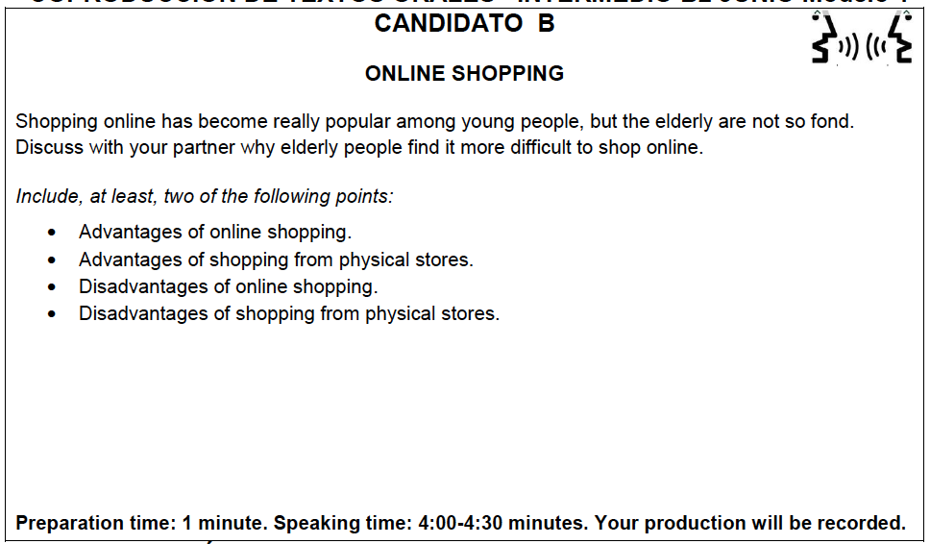

Slide 18
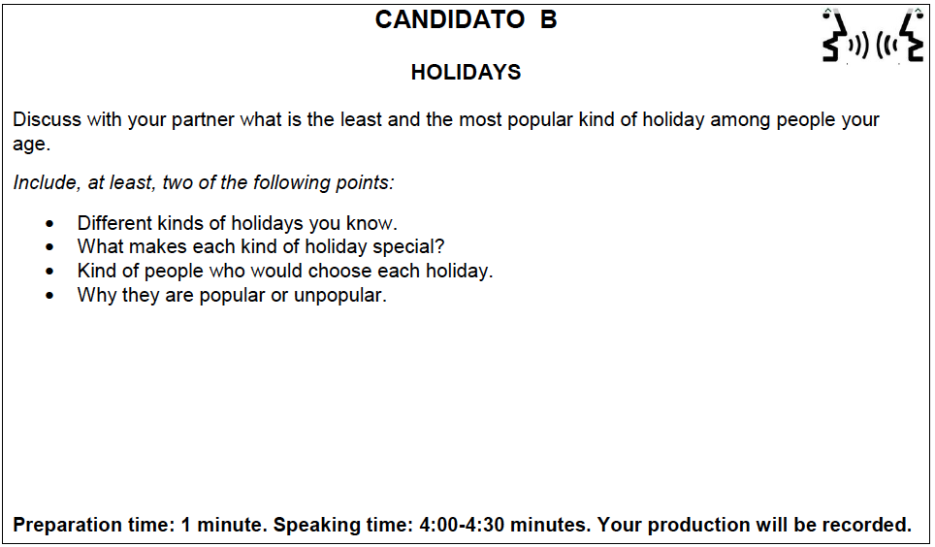

Slide 19
REVISION

Slide 20
personalities

Slide 21
CAN YOU MATCH EACH ADJECTIVE WITH ITS ANTONYM?
ambitious -
generous -
hardworking -
honest -
humble -
independent -
kind -
nervous -
open-minded -
optimistic -
outgoing -
punctual -
reliable -
talkative -
unselfish -
pessimistic
quiet
unmotivated
unreliable
stingy
bigheaded
dependent
inconsiderate
dishonest
self-centered
calm
close-minded
late
lazy
shy

Slide 22
- unmotivated
- stingy
- lazy
- dishonest
- bigheaded
- dependent
- inconsiderate
- calm
- close-minded
- pessimistic
- shy
- late
- unreliable
- quiet
- self-centered
pessimistic
quiet
unmotivated
unreliable
stingy
bigheaded
dependent
inconsiderate
dishonest
self-centered
calm
close-minded
late
lazy
shy
ambitious -
generous -
hardworking -
honest -
humble -
independent -
kind -
nervous -
open-minded -
optimistic -
outgoing -
punctual -
reliable -
talkative -
unselfish -
ANSWERS

Slide 23
Holidays

Slide 24
Vocabulary Match each word with its definition
a. an organised group shown around a place of interest by an expert
b. to look around the tourist sites
c. a place where very few people go for a holiday
d. to take a holiday to escape a busy or stressful lifestyle
e. a special holiday that you are unlikely to repeat
f. a place where lots of people go for a holiday
g. in or into an isolated place
h. outside of the main holiday period
i. a cheap form of accommodation
j. a cheaper form of flying than a scheduled flight
k. an extended weekend holiday including Friday or Monday
l. where you go for a holiday
m. somewhere where too many tourists go
n. a holiday where you supply your own food
to get away from it all
the holiday of a lifetime
off the beaten track
to go sightseeing
guided tours
holiday resorts
package holiday/ all-in package
long weekend
holiday destination
youth hostel
to go out of season
charter-flights
tourist trap
self-catering

Slide 25
Vocabulary (answers)
to get away from it all
the holiday of a lifetime
off the beaten track
to go sightseeing
guided tours
holiday resorts
package holiday/ all-in package
long weekend
holiday destination
youth hostel
to go out of season
charter-flights
tourist trap
self-catering
d. to take a holiday to escape a busy or stressful lifestyle
e. a special holiday that you are unlikely to repeat
g. in or into an isolated place
b. to look around the tourist sites
a. an organised group shown around a place of interest by an expert
f. a place where lots of people go for a holiday
k. an extended weekend holiday including Friday or Monday
l. where you go for a holiday
i. a cheap form of accommodation
h. outside of the main holiday period
j. a cheaper form of flying than a scheduled flight
n. somewhere where too many tourists go
m. a holiday where you supply your own food

Slide 26
The environment

Slide 27
JEOPARDY

Slide 28
Online Privacy

Slide 29
Vocabulary
Data /ˈdeɪtə/
Policy
Breach
Campaign
Notify
Scandal
Whistle-blower
Backlash
Testify
Regulate
Default
Opt out
An administration’s set of regulations and procedures
An organized effort to promote a candidate or a cause
To tell, to make someone aware of something
Information that can be stored and shared digitally
Information that becomes public and is damaging to one’s reputation
Preselected user settings that can be changed by the user
A failure to observe a rule or law
To control through laws or rules
A strong negative reaction
To choose not to use or participate in
A person who makes scandalous information public
To give one’s account of what happened before a court

Slide 30
Vocabulary (answers)
Data
Policy
Breach
Campaign
Notify
Scandal
Whistle-blower
Backlash
Testify
Regulate
Default
Opt out
d. Information that can be stored and shared digitally
An administration’s set of regulations and procedures
g. A failure to observe a rule or law
b. An organized effort to promote a candidate or a cause
c. To tell, to make someone aware of something
e. Information that becomes public and is damaging to one’s reputation
k. A person who makes scandalous information public
i. A strong negative reaction
l-To give one’s account of what happened before a court
h. To control through laws or rules
f. value that a variable will have if no action is taken by the user.
j. To choose not to use or participate in

Slide 31
Technology

Slide 32
Jeopardy

Slide 33
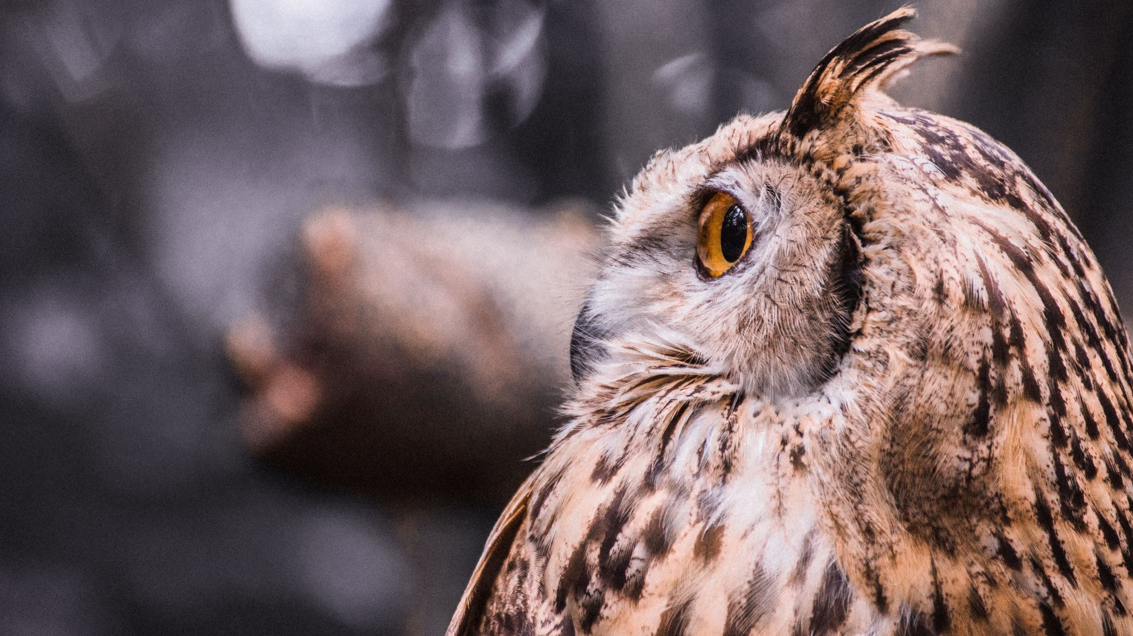
Wildlife

Slide 34
Match the following habitats with the wildlife that is typically found there.
Habitat
1. a savanna
2. a rainforest
3. a temperate forest
4. a reef
5. a desert
6. a lake
Wildlife
a. bears, bees, wild boar, wolves
b. fish, beavers, frogs, dragonflies
c. lions, giraffes, cheetahs, crocodiles, bushes
d. monkeys, jaguars, leopards, parrots
e. scorpions, lizards, snakes, camels, cactus plants
f. sharks, rays, eels, coral

Slide 35
ANSWERS
Habitat
1. a savanna
2. a rainforest
3. a temperate forest
4. a reef
5. a desert
6. a lake
Wildlife
c. lions, giraffes, cheetahs, crocodiles, bushes
d. monkeys, jaguars, leopards, parrots
a. bears, bees, wild boar, wolves
f. sharks, rays, eels, coral
e. scorpions, lizards, snakes, camels, cactus plants
b. fish, beavers, frogs, dragonflies

Slide 36
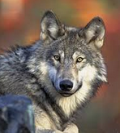
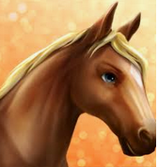
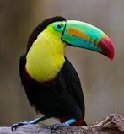
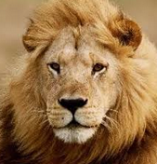
NATURE SOUNDS
1. roar like a
2. chirp like a
3. howl like a
4. grunt like a
5. quack like a
6. cluck like a
7. squawk like a
8. neigh like a
lion
bird
wolf
pig
duck
chicken
parrot
horse

Slide 37
Animal body parts

Slide 38
beak
paws
gills
tusks
fin
spots
hooves
claws
stripes

Slide 39
Animals in action
1. The animals are grazing in the field.
a. eating grass b. resting c. sleeping
2. The predator is about to pounce on its prey.
a. spit b. jump c. fall
3. The birds are feeding their young.
a. giving food to b. caring for c. protecting
4. The dog is sniffing something.
a. licking b. playing with c. smelling

Slide 40
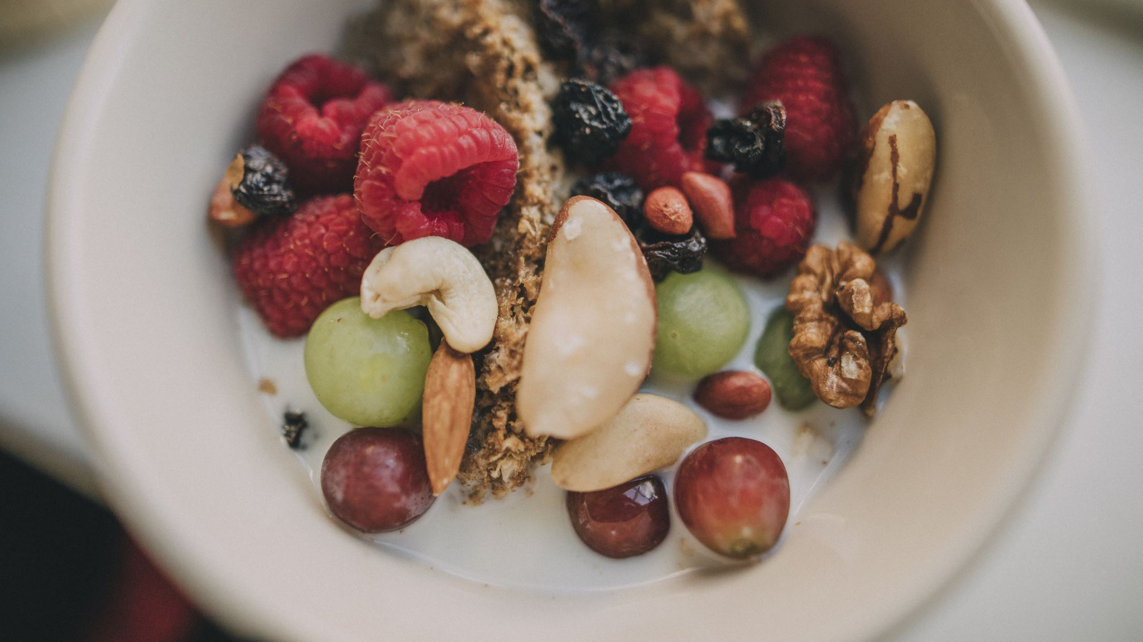
Food

Slide 41
Now complete the definitions with the underlined words above. More than one answer may be possible
1. I bought the bread this morning, but it already tastes _________ !
2. The meat has been out of the fridge for a week. If you eat it, it will taste _________.
3. This soup is a bit _________ . I think you need to season it.
4. The chef uses lots of limes and lemons in his sauces. They have a very _________ flavour.
5. This is the best cake I've ever eaten. It's absolutely _________.
6. The milk tastes a bit _________. How long has it been out of the fridge?
7. This dish is _________. You really know how to cook.
8. The meal at that canteen was _________ ! I'm never going back there again.
stale
rancid
tasteless
zesty
mouthwatering
off
yummy
nasty

Slide 42
Vocabulary game
Use the words or phrases indicated.
You must follow your partner’s idea or story.

Slide 43
to get away from it all
the holiday of a lifetime
off the beaten track
to go sightseeing
guided tours
holiday resorts
package holiday/
all-in package
long weekend
holiday destination
youth hostel
to go out of season
charter-flights
tourist trap
self-catering
brochure
itinerary
cliffs
backpackers
Jet lag
cottage
landscape
hippy
sunburn
pony
canals
currency
Multinational chain
accommodation

Slide 44
A letter/ speech to future students
what was the hardest part of the course?
what was the best part?
what did you enjoy the most?
what’s the most effective way to keep up with the course?
what did you think about the coursebook?
what was the most memorable class?
who would you recommend taking this course to?
any words of wisdom regarding the teacher?

Slide 45
Goodbye
I’m glad I was your teacher
I’ve got used to you and so
I can’t believe the end is here
I hate to see you go.
I’ve watched you learn
From day to day
I hope that all the things we’ve done
have helped you in some way.
So it’s with happy memories that
I send you on your way
With great hope and expectations
I know you’ll be OK.
Remember all the issues we faced
And yet, all the fun we had
But most of all remember
No matter what, YOU CAN!

