Slide 1
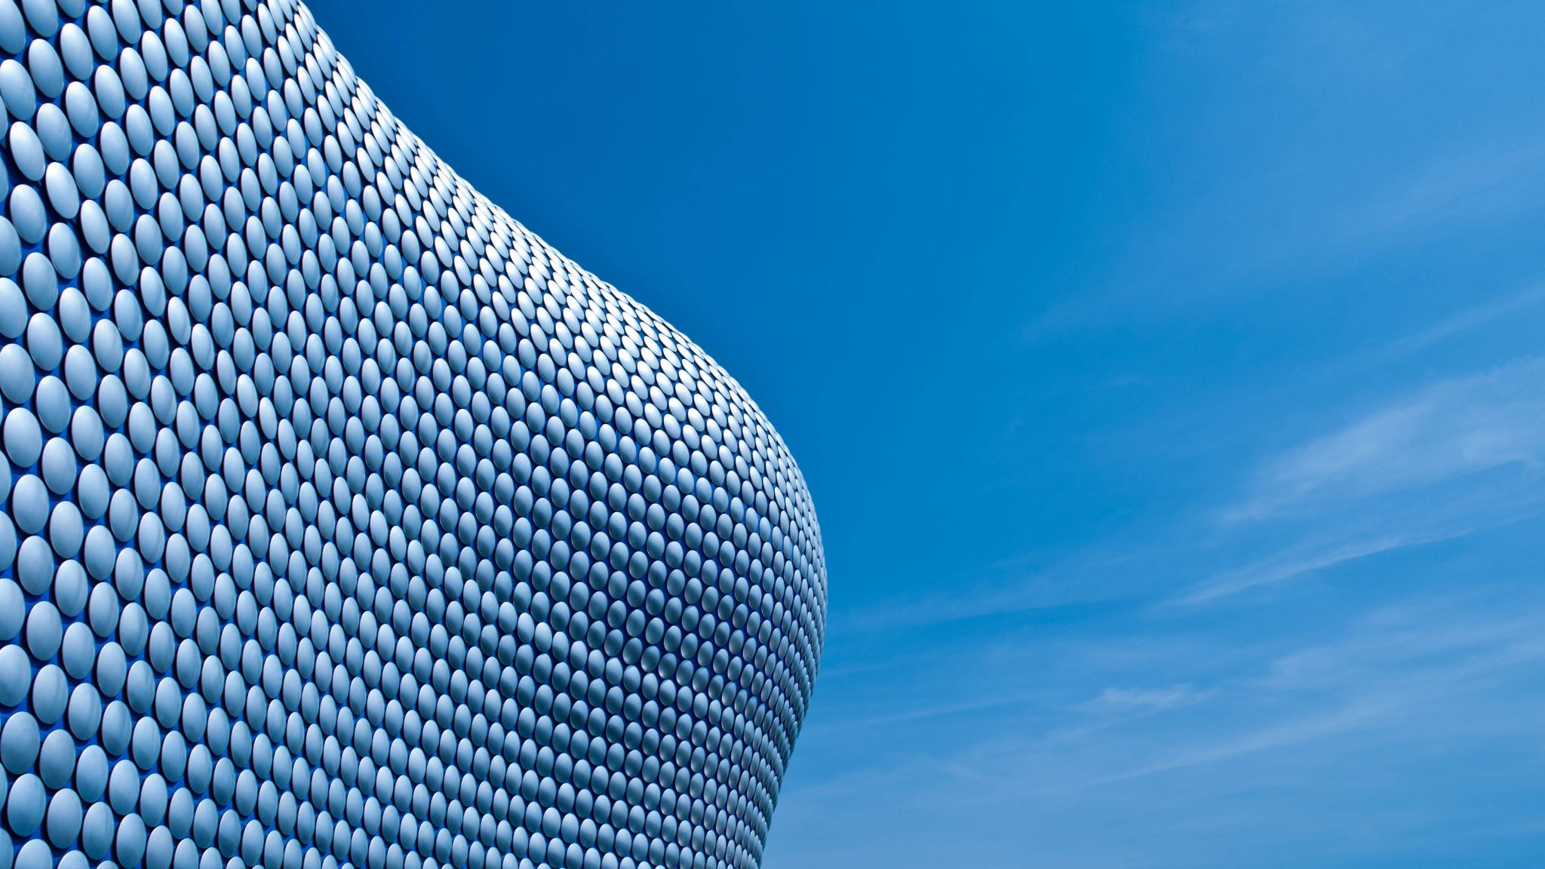
OPINION ESSAY

Slide 2
INTRODUCTIONS
There is growing trend to consider pets as part of some families, but is it reasonable?
A growing number of households are “adopting” pets. Dogs, cats and even exotic animals like snakes have become a part of some families. However, could we be taking things too far?

Slide 3
INTRODUCTIONS
Why people have pets? What are the advantages and disadvantages of having a pet? Is it worth having a pet?
It is said that the dog is man’s best friend. Undoubtedly, pets have always been a necessary part of our lives. However, nowadays, they have become an essential part of some families. One cannot help wondering if we are taking things too far?

Slide 4
INTRODUCTIONS
The family is an essential element in our life, and animals are part of it. In fact, there are more and more homes with very diverse pets, dogs, cats, birds and so on.
Quite a lot of people have pets in their households. These pets are often treated as relatives. What is your opinion of such relationships? Use specific reasons and examples to support your views.

Slide 5
INTRODUCTIONS
The family is an essential element in our life, and animals are part of it. In fact, there are more and more homes with very diverse pets, dogs, cats, birds and so on.
Our families are important in our lives but, for some, family members may include their pets. Dogs, cats and ever parakeets are taking part in daily family activities. They go on holidays, they are bought clothes and are taken to the “animal” doctor. Have things gone too far?

Slide 6
BODY
Animals are like a human being. The only difference between an animal and a human being is the way they can speak, both need love and affection. Bellow are a few reasons in support of my view:
21st century society has humanised pets. Dogs are taken for walks in their prams and fashion boutiques sell French perfume and clothes for pets. At times, it seems as if the only difference is that they bark or miaow. Undoubtedly, in exchange for all this attention their owners receive uncomplicated love and affection. Perhaps pets deserve to be treated as humans.

Slide 7
BODY
Since our pets bring us all these benefits, we try to reward them in some way. That’s the reason why we tend to treat them as if they were kids. We feed them with human food, we give them sweets, and we even dress them up!
Pets are unquestionably beneficial and, even necessary. This implies that many pet owners consider their four-legged companions as if they were children. In some cases, our domestic friends may be encouraged to sit at the table and share a meal or a coffee. Pet parents may spend small fortunes on the latest pet-fashion. In other words, pets are being rewarded for being pets.

