Slide 1
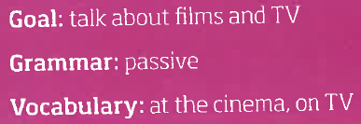
A great show
©Roadmap B1+

Slide 3
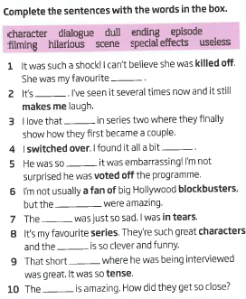
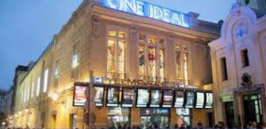
1 character
2 hilarious
3 episode
4 dull
5 useless
6 special effects
7 ending
8 dialogue
9 scene
10 filming

Slide 4
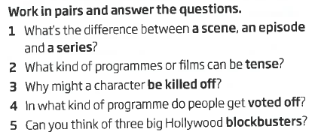

Slide 5
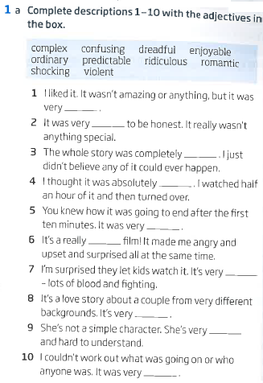
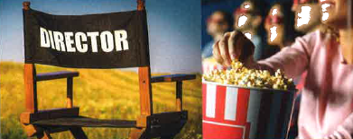
1 enjoyable
2 ordinary
3 ridiculous
4 dreadful
5 predictable
6 shocking
7 violent
8 romantic
9 complex
10 confusing

Slide 6
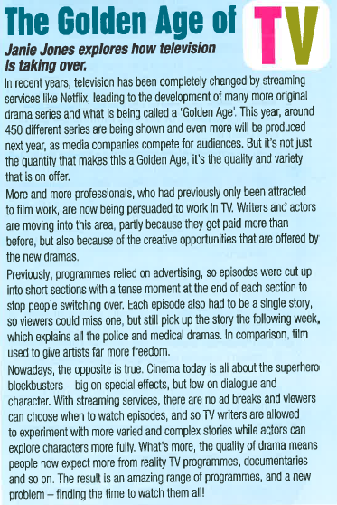
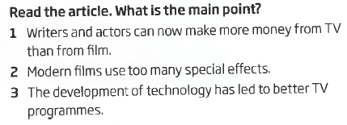
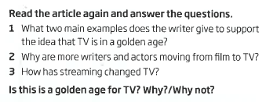

Slide 7
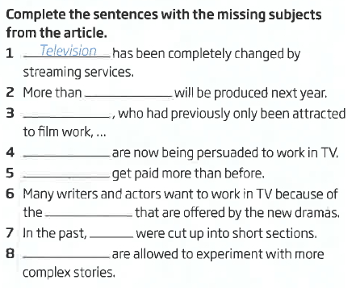
2 450 different series 3 More and more professionals
4 More and more professionals 5 Writers and actors
6 creative opportunities 7 episodes
8 TV writers

Slide 9
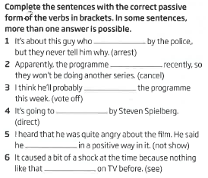
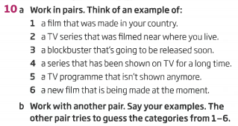
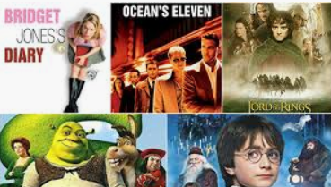
1 is arrested 2 was/has been cancelled
3 be voted off 4 be directed
5 wasn’t/hadn’t been shown 6 had been seen

Slide 10
SPEAKING
Complete the sentences so that they are true for you. Then compare with your partner.
The most terrible film I’ve ever seen was…
My favourite comedy is…
The most brilliant actor in my country is…
I’d give the Oscar for the most amazing performance to…
The best place to read film reviews is…
Think of a TV programme or film and make notes.
Title, genre, director, stars.
When and where it is set.
What happens in it.
What you particularly (dis)like about the plot and characters.
The best/worst scene.
How it made you feel.
Discuss your TV programmes/films in pairs.
Report back to the class. Did anybody choose the same film/TV programme?

