Slide 1
Participle clauses
February 2019
C1.1

Slide 2
ECONOMY
In English, participle clauses are mainly used in writing in order to put a lot of information into one sentence.
There are three kinds of participles in English: present participle, past participle and perfect participle.

Slide 3
Participle clauses
Participle clauses are a form of adverbial clause which enables us to say information in a more economical way.
We can use participle clauses when the participle and the verb in the main clause have the same subject.

Slide 4
and whistled.
She left the house
While I was waiting for John,
I made some tea.
whistling.
Waiting for John,

Slide 5
Forming participle clauses
Participle clauses can be formed with
the present participle (-ing form of the verb)
past participle (third form of the verb).
Participle clauses with past participles have a passive meaning.

Slide 6
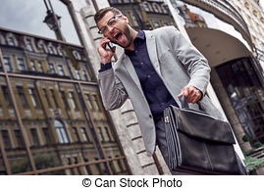
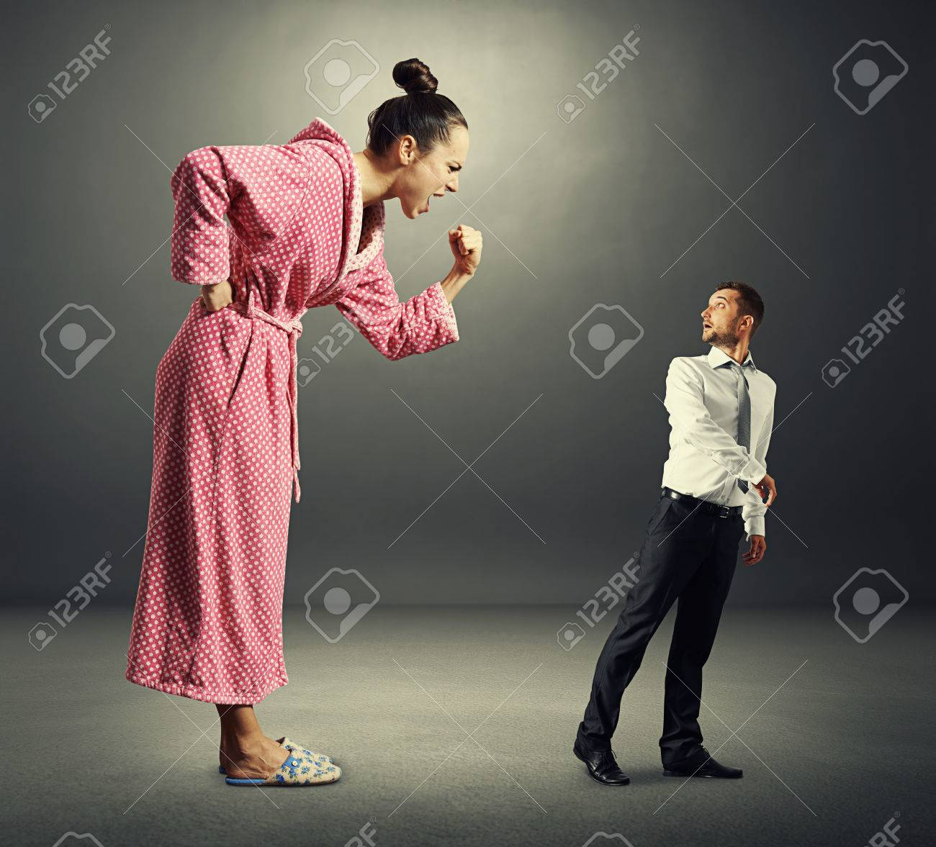
Present and past participles
While Peter was shouting loudly, Peter walked home.
While Lucy shouted at Peter loudly, Peter walked home.
Shouting loudly, Peter walked home.
Shouted at loudly, Peter walked home.
Peter was shouting.
Lucy was shouting at Peter or Peter was shouted at by Lucy.

Slide 7
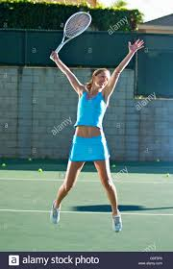
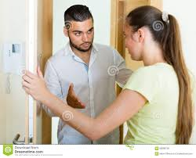
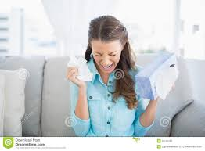
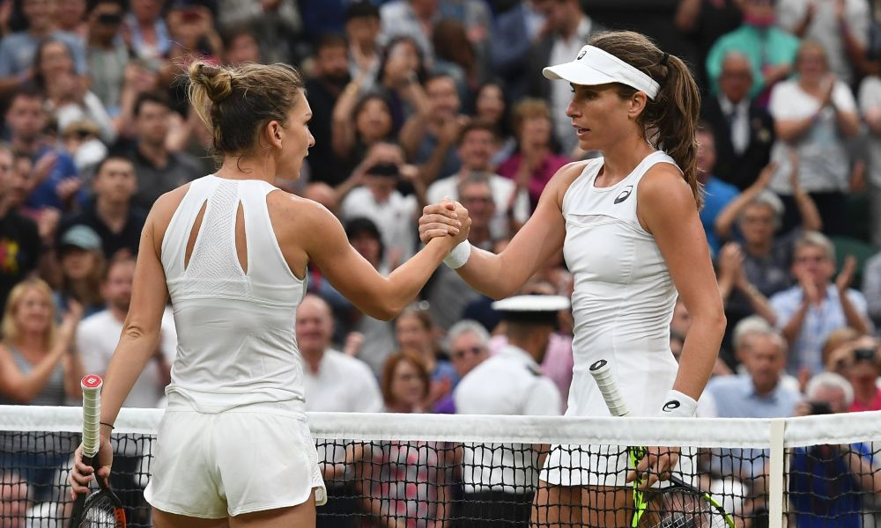
One action after another
If we wish to emphasise that one action was before another we can use a perfect participle (having + past participle):
Susan won the match and then she jumped for joy.
Peter told Susan the bad news and then she sat down and started crying.
Having won the match, Susan jumped for joy.
Having been told the bad news, Susan sat down and started crying.

Slide 8
meanings
CONDITION (with a similar meaning to an if-condition):
Looked after carefully, this coat will keep you warm through many winters.
Compare: If you look after it carefully, this coat will keep you warm through many winters.

Slide 9
meanings
RESULT (with a similar meaning to so or therefore):
The bomb exploded, destroying the building.
Compare: The bomb exploded so the building was destroyed.

Slide 10
meanings
REASON (with a similar meaning to because or since):
I had no time to read my book, having spent so long doing my homework.
Compare: I had no time to read my book because I had spent so long doing my homework.

Slide 11
meanings
TIME (with a similar meaning to words like when, while or as soon as):
Sitting at the cafe with my friends, I suddenly realised that I had left the oven on at home.
Compare: While I was sitting at the cafe with my friends, I suddenly realised that I had left the oven on at home.

Slide 12
EXERCISES

Slide 13
I have a cat that is called Tari.
I have a cat called Tari.
The dinner was more expensive than they had expected.
The dinner was more expensive than expected.
He was accused of murder and arrested.
Accused of murder he was arrested.

Slide 14
She was shocked by the bad news and burst into tears.
Shocked by the bad news she burst into tears.
She was born in Hollywood and knows all the famous movie stars.
Born in Hollywood she knows all the famous movie stars.
The film is based on real events and tells the story of a reporter.
Based on real events the film tells the story of a reporter.

Slide 15
We switched off the lights before we went to bed.
Having switched off the lights, we went to bed.
The boy asked his mother's permission and then went out to play.
Having asked his mother's permission, the boy went out to play.
As he had drunk too much, he didn't drive home himself.
Having drunk too much, he didn’t drive home himself.

Slide 16
We have written two tests today, so we are very exhausted.
Having written two tests today, we are exhausted.
She filled the washing machine and switched it on.
Having filled the washing machine, she switched it on.
She had been to the disco the night before and overslept in the morning.
Having been to the disco the night before, she overslept in the morning.

Slide 17
Need more?

Slide 18
Further practice
English Practice Online
Grammar Bank. Com
Lingolia exercises
English Grammar (9 minutes)
BBC English Masterclass – Participle clauses (4 minutes)

